Slide 1
Machine Learning in Python
WiDS@UBC
Annie Wang
Notes:
Hi everyone, welcom to the intro to ML workshop.

Slide 2
Agenda
Introduction to Machine Learning
Tools and Libraries
Machine Learning in Action – Example
Notes:
In this workshop you're going to learn how to solve a real-world problem using machine learning and python. We will start with a brief intro to ML in the slides, and then I will introduce the tools you need, after that we will jump right into an example which is the problem we’re going to solve using one of the Machine Learning models. You’ll learn how to build a model that can learn and predict the kind of

Slide 3





Machines can learn too
Machine learning Concept consists of getting computers to learn from experiences-past data.
Machines ”learn” by finding patterns in similar data.
From what it ”learned”, Machines can predict the future, as long as the future doesn’t look too different from the past.
Notes:
To keep things simple, just know that machines “learn” by finding patterns in similar data. Think of data as information you acquire from the world that are related to your problem statement. The more data given to a machine, the “smarter” it gets. So Machine needs data to train == finding patterns in data.
[tap] Let’s say you’re building a model that recognize your face when you’re unlocking your iPhone. AKA the Face ID. Using traditional programming techniques your program is going to get very complex and you will have to come up with tons of conditions and rules to look for specific curves edges and shapes of the face. But that will not work all the time, cuz each time you unlock your phone, you are holding if from a different angle, or under diff lightings. So you may need to rewrite your program to deal with a new angle.
Machine learning is a technique that solves theses kind of problems and this is how it works, we build a model and give if lots and lots of data, so it can learn patterns in the input data. So it can then predict whether it is you or not every time you scan you face under a different environment.

Slide 4

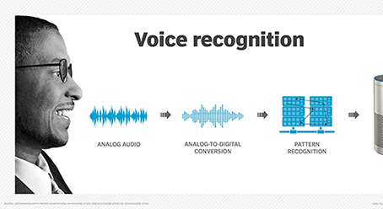
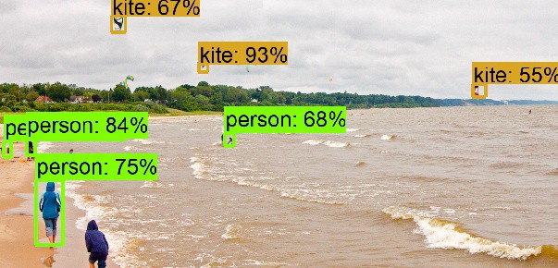
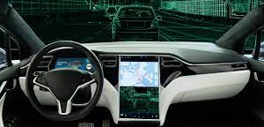
Notes:
Machine learning is a type of artificial intelligence, where the computer "learns" about something without being explicitly programmed. The approach can be used for tasks such as spam filtering, image recognition, and natural language processing (NLP). This AI-based method has also been incorporated into other applications including self-driving cars, personal assistants, and online advertising.

Slide 5
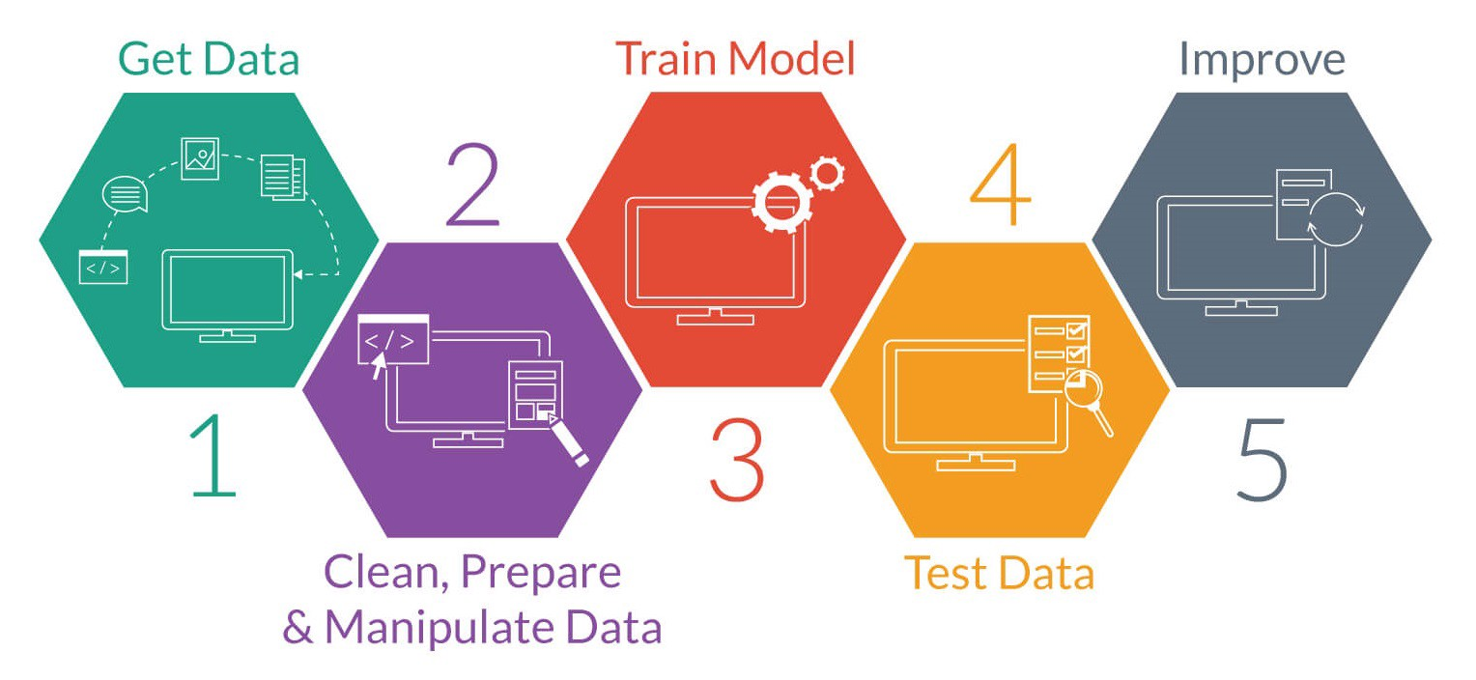
steps of involved in ML project
1. Import data
2. Clean data
3. Train Model (using ML algorithm)
Split the data into Train/Test sets
Create a Model
Train the model
4. Make Predictions
5. Improve Model Accuracy
Notes:
A ML project involves a number of steps, the first step is to obtain data (usually from database/online) and import the data which often comes in the form of a csv file. Next we need to clean it, for instance we want to remove the duplicates and rows that have lots of empty values (incomplete), we want to remove those because they are going to mislead our machine to learn the wrong pattern from the data, and thus produce the wrong prediction, This step is really dataset dependent, and different projects may apply different data cleaning steps.
Next is Traning the model, and it is where we will spent the most of the time today:
- It involves some sub steps including splitting the data into Train/Test sets, so we could use some of feed it into the machine for learning and use the test sets to evaluate how well the model predicts for new data. Then we will choose an appropriate algorithm to create a model, there are so many ML models, each with their pros and cons and are used under different use cases (this is usually the hardest part and involves lots of research and help from statitians).
- So we build a model using the algorithm. Next we need to train our model so we fitted our training data (that’s the train split from the input data). The model will then look for the patterns in the data.
So next we can ask it to make predictions using the test data, it’s likely that some of the predictions are inaccurate (just like you are training for an exam, but by the time of the test, you might still make a few mistacks). So we need to evalute the predictions and measure the accuracy then improve it by retraining the model and modify some of the parameters in the algorithm. (we are going to cover step 5 in our future workshop).

Slide 6
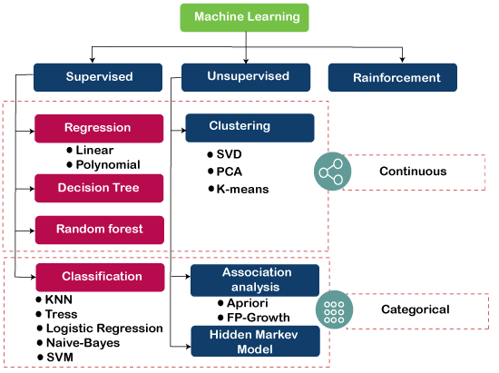

Machine Learning Algorithms
Machine Learning algorithms are the programs that can learn the hidden patterns from the data, predict the output, and improve the performance from experiences on their own
Machine learning Algorithms Library
Notes:
As I said there are lots of ML algorithms, the image given above is not even complete. But for this workshop I want you to know that Machine Learning algorithms are the programs that can learn the hidden patterns from the data, predict the output, and improve the performance from experiences on their own. The algorithm you choose depends on the kind of problem you are trying to solve and your input data.
Now the good news is that we don’t have to explicitly program an algorithm there are libraries out there the provide these algorithms. One of the most popular one we are going to use is scikit-learn.

